Slide 1
Plant Responses
Tropism

Slide 2
Tropism
Tropisms
Growth movement related to direction of the stimulus.
Phototropism
Growth movement or response in which parts of a plant grow towards or away from the direction from which light is coming.
Geotropisms
Growth movement or response in which parts of a plant grow towards or away from gravity.
Positive response: growth movements towards the stimulus.
Negative response: growth movements away from the stimulus.
Examples
•A stem growing towards light is positive phototropism.
•A stem growing upwards (away from gravity) is a negative geotropism.

Slide 3
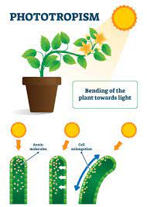
Advantages of Phototropisms in Plants
•A shoot brings its leaves into the best situation to absorb light for photosynthesis.
•Flowers are most likely to be seen and pollinated by insects.
•Easy dispersal of seeds fruits.

Slide 4
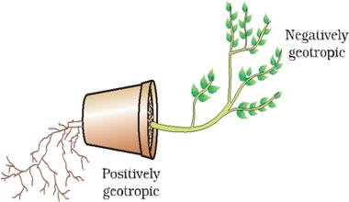
Advantages of geotropisms in Roots
Roots penetrate the soil,and anchor the plant.
•Roots find sources of water and mineral salts.

Slide 5
Auxin
are plant hormones, also known as growth regulating substances, they are produced by the shoot tip or root tip, and diffuse to the region of elongation to produce an effect.
•Auxins in shoot enhance growth.
•Auxins in root inhibit or slow down growth.

Slide 6
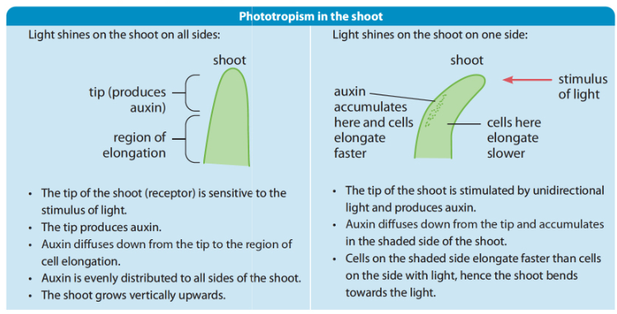
How Auxin works in Shoots?

Slide 7
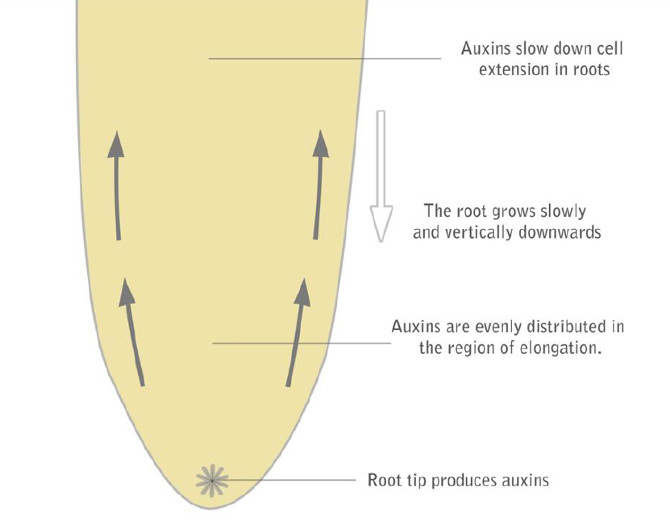
Positive Geotropism in Roots
1st case:
(with the root in vertical position )
Root tip produces auxins which pass back by diffusion to the elongation zone, auxins slow down cell growth.
This is positive geotropism.

Slide 8
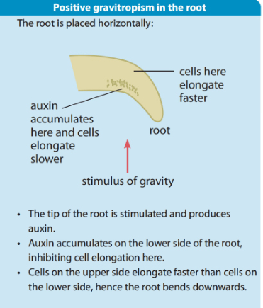
Positive Geotropism in Roots
2nd case:
(with the root in horizontal root position)
•Root tip produces auxins which pass back by diffusion and unevenly distributed more on the lower side.
•Auxins slow down cell growth of the lower side and the root bends towards gravity.

Slide 9
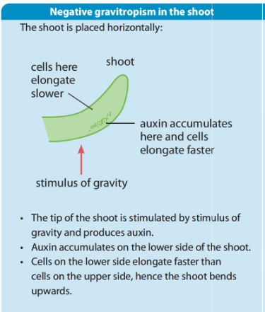
Negative Geotropism in Shoots

Slide 10
Experiments on tropism

Slide 11
Experiment One: Geotropism in pea radicles
Twenty soaked pea-seeds are allowed to germinate for 3 days
•Pin 6 of the seeds with straight radicles to a clinostat so that the radicles are horizontal.
•Pin another 6 to a cork in a jar .
•Keep the jar and clinostat in the same conditions of light and temperature for about 2 days.
•Clinostat is an electric turn table which rotates the seedling slowly about four times an hour.

Slide 12
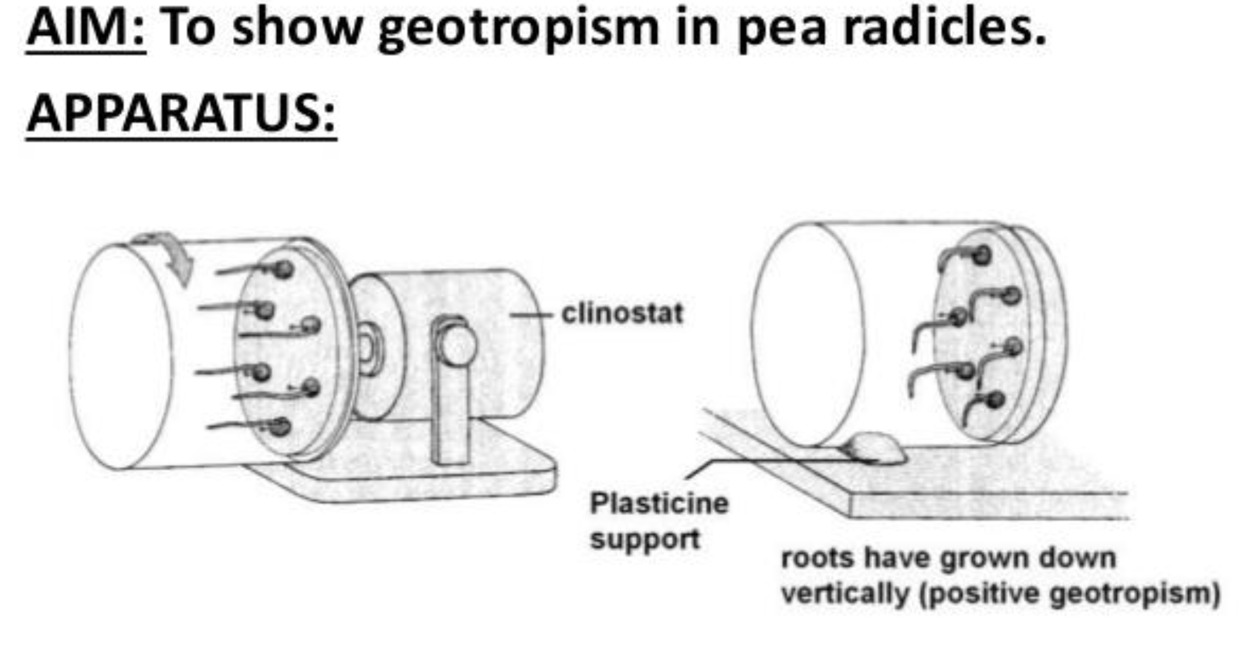

Slide 13
Result
•The radicles in the jar bend and grow vertically downwards.
•The radicles in the clinostat will continue to grow horizontally straight.
Explanation
•Pea radicles in the jar are affected by one sided stimulus, auxins are unevenly distributed, more on the lower side. Auxins reduce the growth of the lower side and the roots respond by bending towards gravity. (positive geotropism).
•Pea radicles in clinostat are not affected by one-sided stimulus because of the rotation of the clinostat so that the gravity affects all sides equally and the radicles grow straight horizontal, due to the even distribution of auxins.

Slide 14
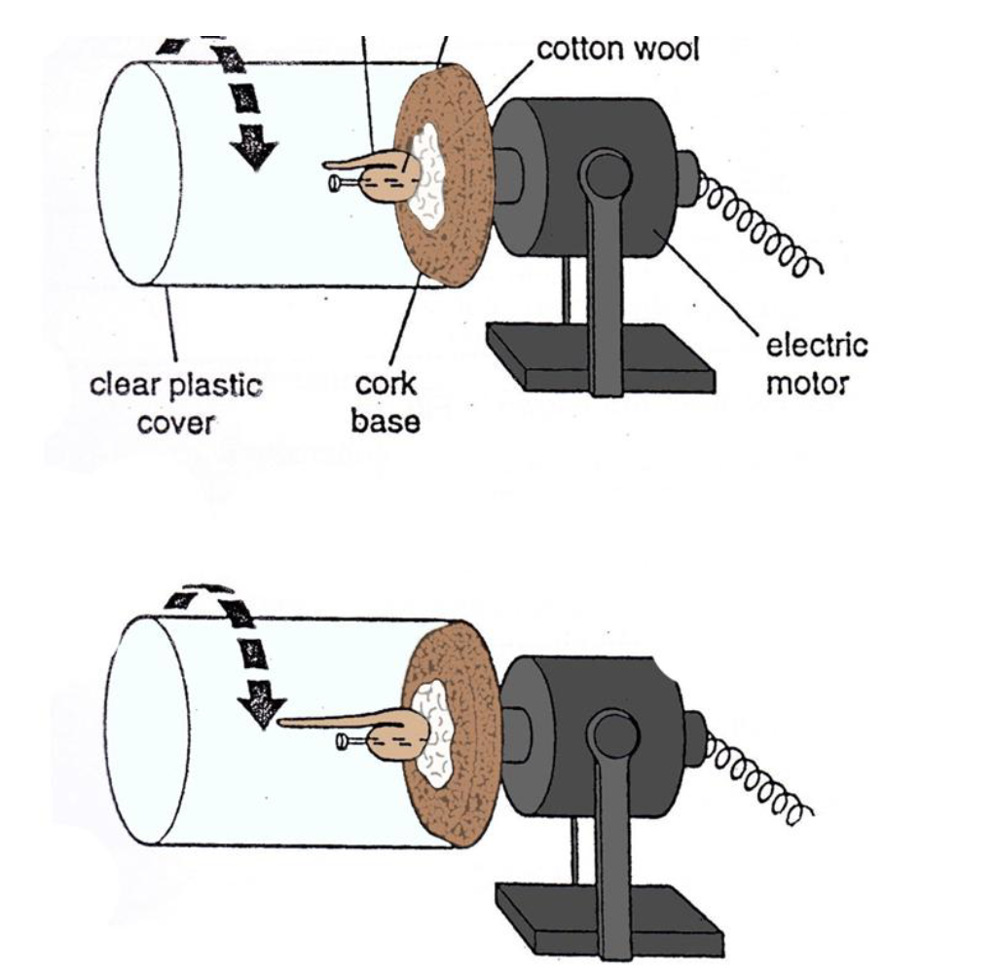
Experiment Two Phototropism in shoots
•Take 2 potted bean seedlings A and B (of similar size).
•A is placed under a cardboard box with a window cut in one side for light to reach the plant from one direction.
•B is placed in an identical situation but on a clinostat (control).
•Both are kept in an identical conditions for 2 days.
•Result
•The stem of plant A bends by growing towards the light.
•Plant B continues to grow straight vertically upward.
Explanation
•Plant A has responded to one-sided lighting by growing towards the light (positive phototropism).
•Plant B (control) is not affected by the one sided stimulus. The rotation of the clinostat has allowed light to act on all sides equally and the shoot grows vertically upwards. Explain in term of auxins.

Slide 15
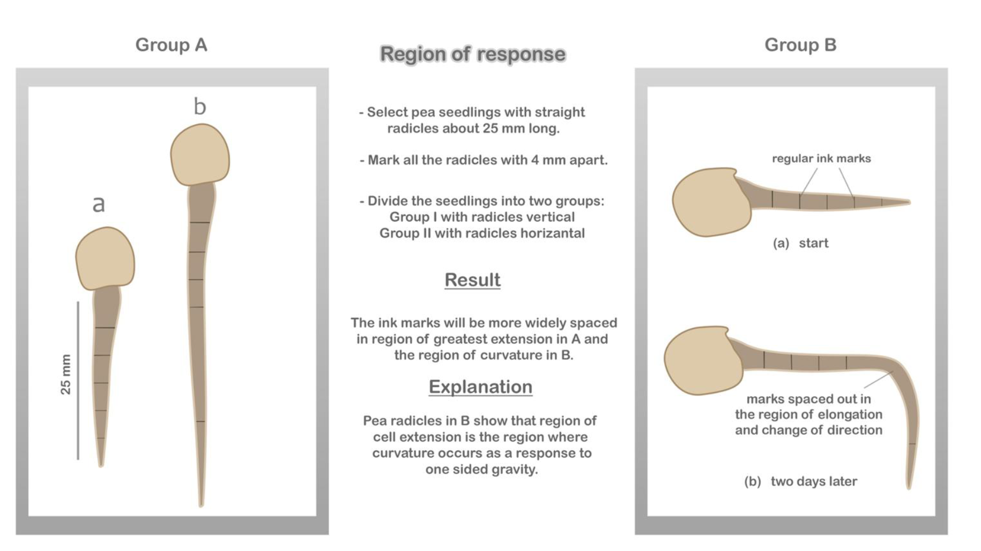
Experiment Three Region of response

Slide 16

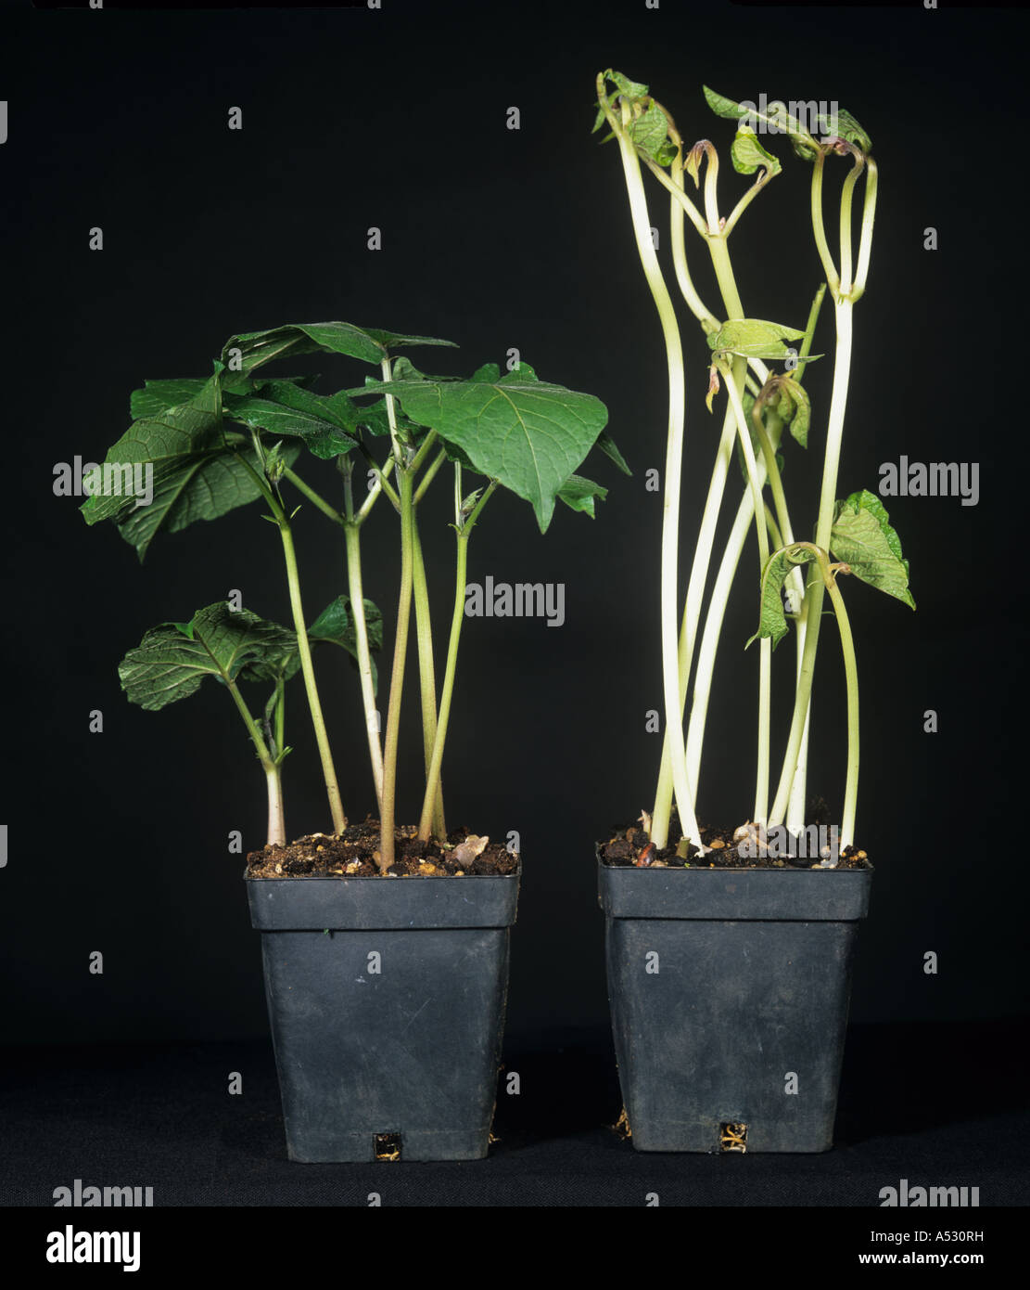




Etiolation
Seedlings growing in the dark are very pale, tall and thin.
In darkness, auxin is also distributed evenly around the shoot behind the tip, and the shoot grows rapidly upwards.
But chloroplasts do not develop well in darkness.
Therefore plants without light become yellow, spindly (long and thin and usually weak) and have smaller leaves.
Plants like this are said to be etiolated.
If the plants reach the light, chlorophyll will develop, and the plants will begin to grow normally.
If they do not reach light, they die because they cannot photosynthesize.

